Slide 1
IBM ILOG CPLEX Optimization Studio学院计划

Slide 2
IBM ILOG CPLEX Optimization Studio 对学院用户完全免费
包括CPLEX 优化器, CP 优化器, 建模语言以及建模环境OPL
功能和商业版完全一样，而且没有变量和约束规模限制
简单的申请流程
  http://www.ibm.com/developerworks/forums/thread.jspa?threadID=335577&tstart=0

Slide 3


CPLEX Optimization Studio 12.2
Model Development Tools
CPLEX Studio (IDE) - OPL Modeling Language
Connectors
Microsoft Excel
MSF
MATLAB
AMPL
Python
Tools
CPLEX Interactive
ILOG Concert Technology (C++, .NET, Java)
New
Optimization Engines
New
Math Programming
CPLEX Optimizers
(Mixed integer) LP/QP/QCQP/SOCP
Constraint Programming
CPLEX CP Optimizer
(Especially suitable for scheduling problem)
Running with multiple parallel CPUs by default

Slide 4
Application of Constraint Programming: Scheduling
// x is 1 if job j starts at time t
dvar boolean x[1..nbJobs][0..maxTime];
// w[j] number of resources used by job k - s[j] due date
minimize sum(j in 1..nbJobs, t in s[j]..maxTime) x[j][t]*w[j]*(t-s[j]);
constraints {
forall(j in 1..nbJobs)
sum(t in 0..maxTime) x[j][t] == 1;
forall(t in 0..maxTime)
sum(j in 1..nbJobs, t2 in maxl(0, t - d[j] + 1)..t) x[j][t2]*w[j] <= M;
}
MIP formulation
number of x variables depends on time granularity
180 seconds: cost of 8717
// interval when job j is performed
dvar interval x[j in 1..nbJobs] size d[j];
minimize sum(j in 1..nbJobs) w[j]*maxl(0, startOf(x[j]) - s[j]);
constraints {
sum(j in 1..nbJobs) pulse(x[j], w[j]) <= M;
}
CP formulation
model complexity independent of time granularity
0.73 seconds: cost of 6397
example with 20 jobs and durations between 10 and 100

Slide 5
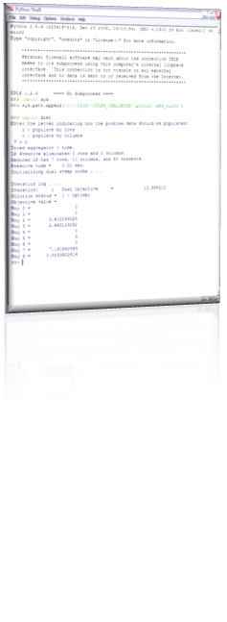
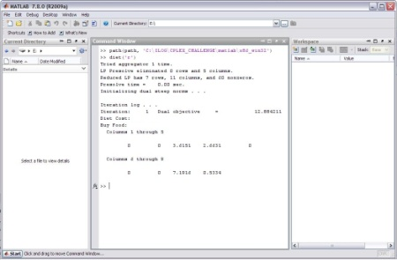
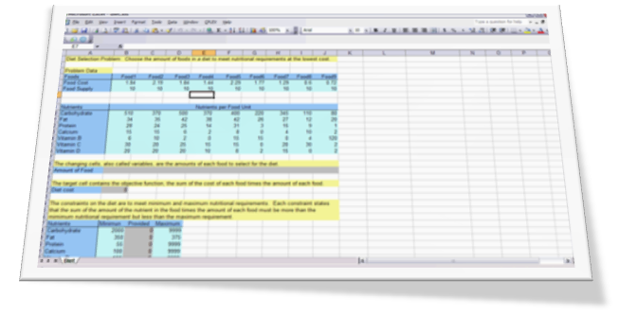
CPLEX 12.2 的建模工具（使用接口）
CPLEX Optimization Studio 自带的建模工具
  Concert Technology (C++, .NET, Java)
  编程基础好的人；计算机系学生；应用程序开发
  MATLAB 接口 对MATLAB熟悉的人
  Excel插件 《运筹学》课程教学；商学院的学生
  其它：Python / MSF
其它第三方接口
  AMPL / GAMS / AIMMS等建模工具
  YALMIP 建模简单；免费

Slide 6
IBM ILOG 优化实用链接
CPLEX 主页：
www.cplex.com
CPLEX 文档：
http://publib.boulder.ibm.com/infocenter/cosinfoc/v12r2/index.jsp
IBM ILOG Optimization 社区
http://www.ibm.com/developerworks/forums/category.jspa?categoryID=260
CPLEX 社区：疑难交流平台，CPLEX工程师面对面答疑
http://www.ibm.com/developerworks/forums/forum.jspa?forumID=2059&start=0
CPLEX 学院版免费下载以及安装：
http://www.ibm.com/developerworks/forums/thread.jspa?threadID=335577&tstart=0

Slide 7
Questions & Answers
IBM中国开发实验室
CPLEX研发工程师
John Cui
崔友志
jcui@cn.ibm.com
Thank You

